Slide 1

NEWSNUGGET:NEWS ARTICLE SUMMARIZER
Siddhanth Arolkar - (22107017) Harsh Tambde - (23207001)
Project Guide
Mr. Vaibhav Yavalkar

Slide 2
Outline
Introduction
Literature Survey of the existing systems
Limitations of the existing systems
Problem statement
System Design
Technologies and methodologies
Implementation
Conclusion
References

Slide 3
Introduction
In today’s fast-paced world, staying updated with the latest news is
crucial, but finding the time to sift through lengthy articles can be
challenging. That’s where AI News Article Summariser comes in!
Powered by cutting-edge AI, our app instantly condenses long-form news
articles into bite-sized summaries, helping you stay informed without the time commitment.
Motivation
In the digital age, we are constantly bombarded with information,
especially in the form of news articles, reports, and updates from a wide
range of sources. With the sheer volume of content produced daily, it has
become overwhelming to stay informed on current events while juggling
busy schedules. Traditional news reading requires significant time and effort, often leading to information overload or missed stories altogether.

Slide 4

Objectives
Save Time: Readers can get the most important takeaways from articles in seconds, freeing up time for deeper analysis or other tasks.
Reduce Information Overload: With concise summaries, users can efficiently filter through vast amounts of news, focusing on what truly matters to them.
Ensure Inclusivity: Summarizers make complex topics more accessible to a wider audience by distilling the content into easily digestible formats.
Enable Informed Decisions: By quickly staying informed on current events, users can make timely and informed decisions, whether in their personal or professional lives.

Slide 5
Literature Survey of the existing system
SR. TITLE AUTHOR YEAR OUTCOMES METHODOLOGY NO
RESULT
1. Natural Language Processing with Python.
[1]
Stevan Bird, Ewan Klein, Edward Loper.
2009 This book offers N L P e m p l o y The model's
a highly accessible
a d v a n c e d rules were
techniques
like implemented
introduction to
morphological _{in a web-}
natural language ^{a n a l y s i s a n d} based tool,
machine learning _{offering}
processing, the field that supports a variety of language technologies, from predictive text and email filtering to automatic summarization and translation.
algorithms
understand and
^{t o} accurate
p r o c e s s
_{t h e} recommendati
i n t r i c a t e ons tailored to
g r a m m a r a n d specific
word formations conditions
such languages.
(1).

Slide 6
Literature Survey of the existing system
SR. TITLE AUTHOR YEAR OUTCOMES METHODOLOGY NO
RESULT
2. Mastering Pedro
2014
Natural Language Processing (NLP) refer to
Stay ahead of the curve by exploring cutting-edge advancements in
NLTK,
spaCy, and TensorFlow - and leverage their capabilities to conquer any text analysis challenge.In- depth exploration: Go beyond the basics and delve into advanced topics like modeling, and machine translation.
Natural Language Processing with Python and NLTK.
[2]
Martins, Katie Millie
the various tasks NLP, including and applications deep learning and that are possible natural language
through the use of NLP techniques.
These outcomes
have revolutionized how machines process, understand, and generate human language.
generation. Within these pages, you'll discover:. The fundamentals of NLP: Grasp core concepts like PyMaster the functionalities of NLTK, spaCy, and TensorFlow.

Slide 7
Limitations of existing systems
Loss of Context and Nuance: Summarization by its nature reduces
the length of an article, which can result in the loss of important
context, tone, or subtle nuances. AI may struggle to capture the
deeper implications of a story, especially in complex topics like
politics or social issues, where understanding tone or bias is essential.
Difficulty with Ambiguity: AI often has difficulty interpreting ambiguous or highly technical language. In cases where articles include conflicting information, uncertain outcomes, or speculative analysis, the summarizer may misrepresent the article’s intended meaning.
Technical Limitations: AI models, especially language models, can sometimes misinterpret or make errors in understanding language due to limitations in their training data. This can lead to summaries that omit key points or misrepresent the original article.

Slide 8
Problem statement
In today’s fast-paced digital world, vast amounts of news and information are produced every minute, making it challenging for individuals to stay updated without spending excessive time reading long and detailed articles. This information overload can lead to missed important stories, reduced comprehension due to skimming, and inefficiencies in processing relevant information.
There is a need for a tool that can efficiently condense lengthy news articles into accurate, bite-sized summaries while retaining the core information and context. This tool must address the varying needs of different users, from casual readers to professionals seeking timely insights, without compromising the integrity or relevance of the original content.
The challenge lies in creating an AI-powered summarization system capable of:
Extracting key information from diverse types of news articles.
Maintaining accuracy and avoiding misrepresentation.

Slide 9

System Design
1.User Interface (UI)
Purpose: Provides users with an easy-to-navigate platform to input articles, URLs, or access summaries.
Features:Summary Display: Shows the summarized text in a clean and readable format.
Customization Options: Users can specify the length of the summary (e.g., short, medium, long).
2. News Fetcher Module:
Purpose: Automatically fetches articles from various news sources for summarization.
3. Natural Language Processing (NLP) Pipeline:
Text Preprocessing
Summarization Algorithm
Text Post-processing

Slide 10
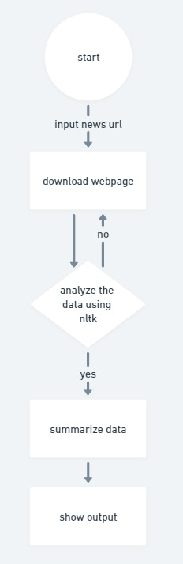

Slide 11
Technologies and methodologies
Front-End:
•
•
HTML CSS
Back-End:
•
•
Python Flask

Slide 12


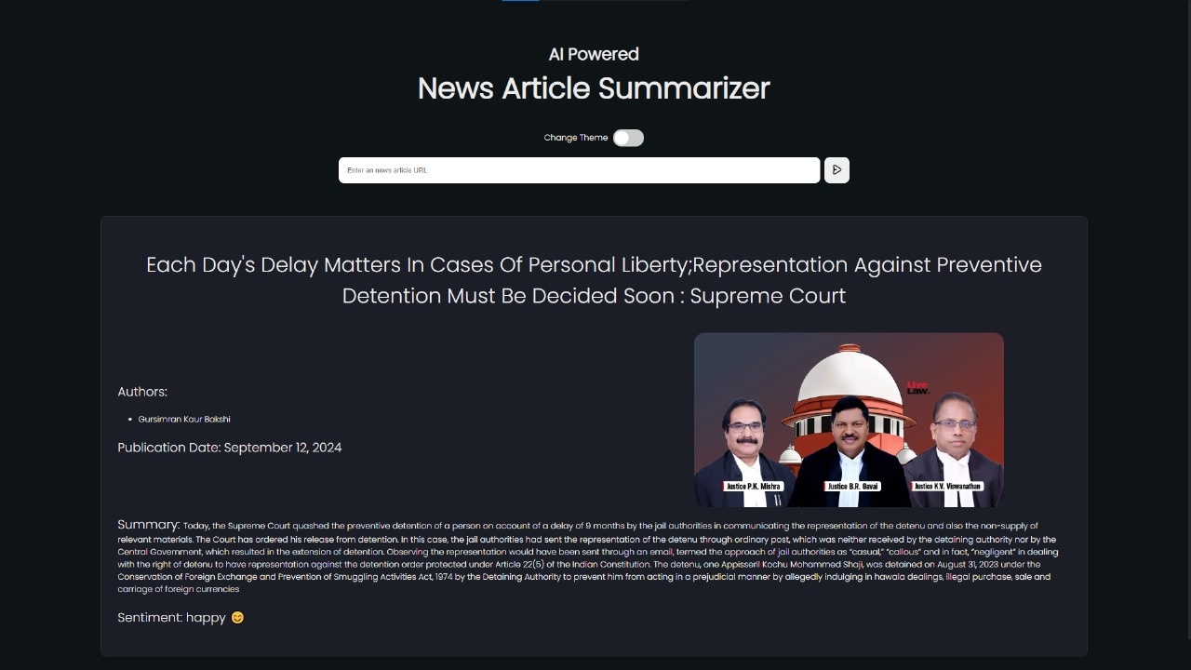
Implementation
Fig. 1: (Homepage)
Fig. 2: (Processed news)

Slide 13
Conclusion
In an era where time is precious and information is abundant, an AI-powered news article summarizer offers an innovative solution to help users stay informed without feeling overwhelmed. By distilling long-form articles into concise and accurate summaries, this tool allows individuals to keep up with current events, important reports, and breaking news efficiently. While it may have limitations in capturing deeper context or nuance, the benefits of quick access to key information are undeniable.
Ultimately, the AI news summarizer empowers users to stay connected with the world, saving time and reducing information overload. As AI technology continues to advance, the future holds even more promise for improving the way we consume and engage with news.

Slide 14
References
Natural Language Processing with Python , Steven Bird , April 2009.
https://ieeexplore.ieee.org/document/7951740
Natural Language Processing, A quick introduction to NLP with Python and NLTK, Samuel Burns, July 2019.
https://ieeexplore.ieee.org/abstract/document/8697349
SMastering Natural Language Processing with Python and NLTK, Pedro Martins, August 2014. https://ieeexplore.ieee.org/document/9418351

Slide 15
Thank You...!!

